Slide 1
CarePilot
World first proactive AI family doctor with hands
February 2026

Slide 2
The Problem
Affordable and accessible Healthcare is a Right
Seeing a doctor is often very expensive
The US healthcare system is owned by greedy entities that will charge hundreds for a simple doctor’s visit
Family doctors have hundreds of patients
Even the person in the healthcare system that knows you the best can only know you on a surface level
The health care system is very slow
It’s common to have to wait for days for an appointment or hours in line to see a doctor or a specialist

Slide 3
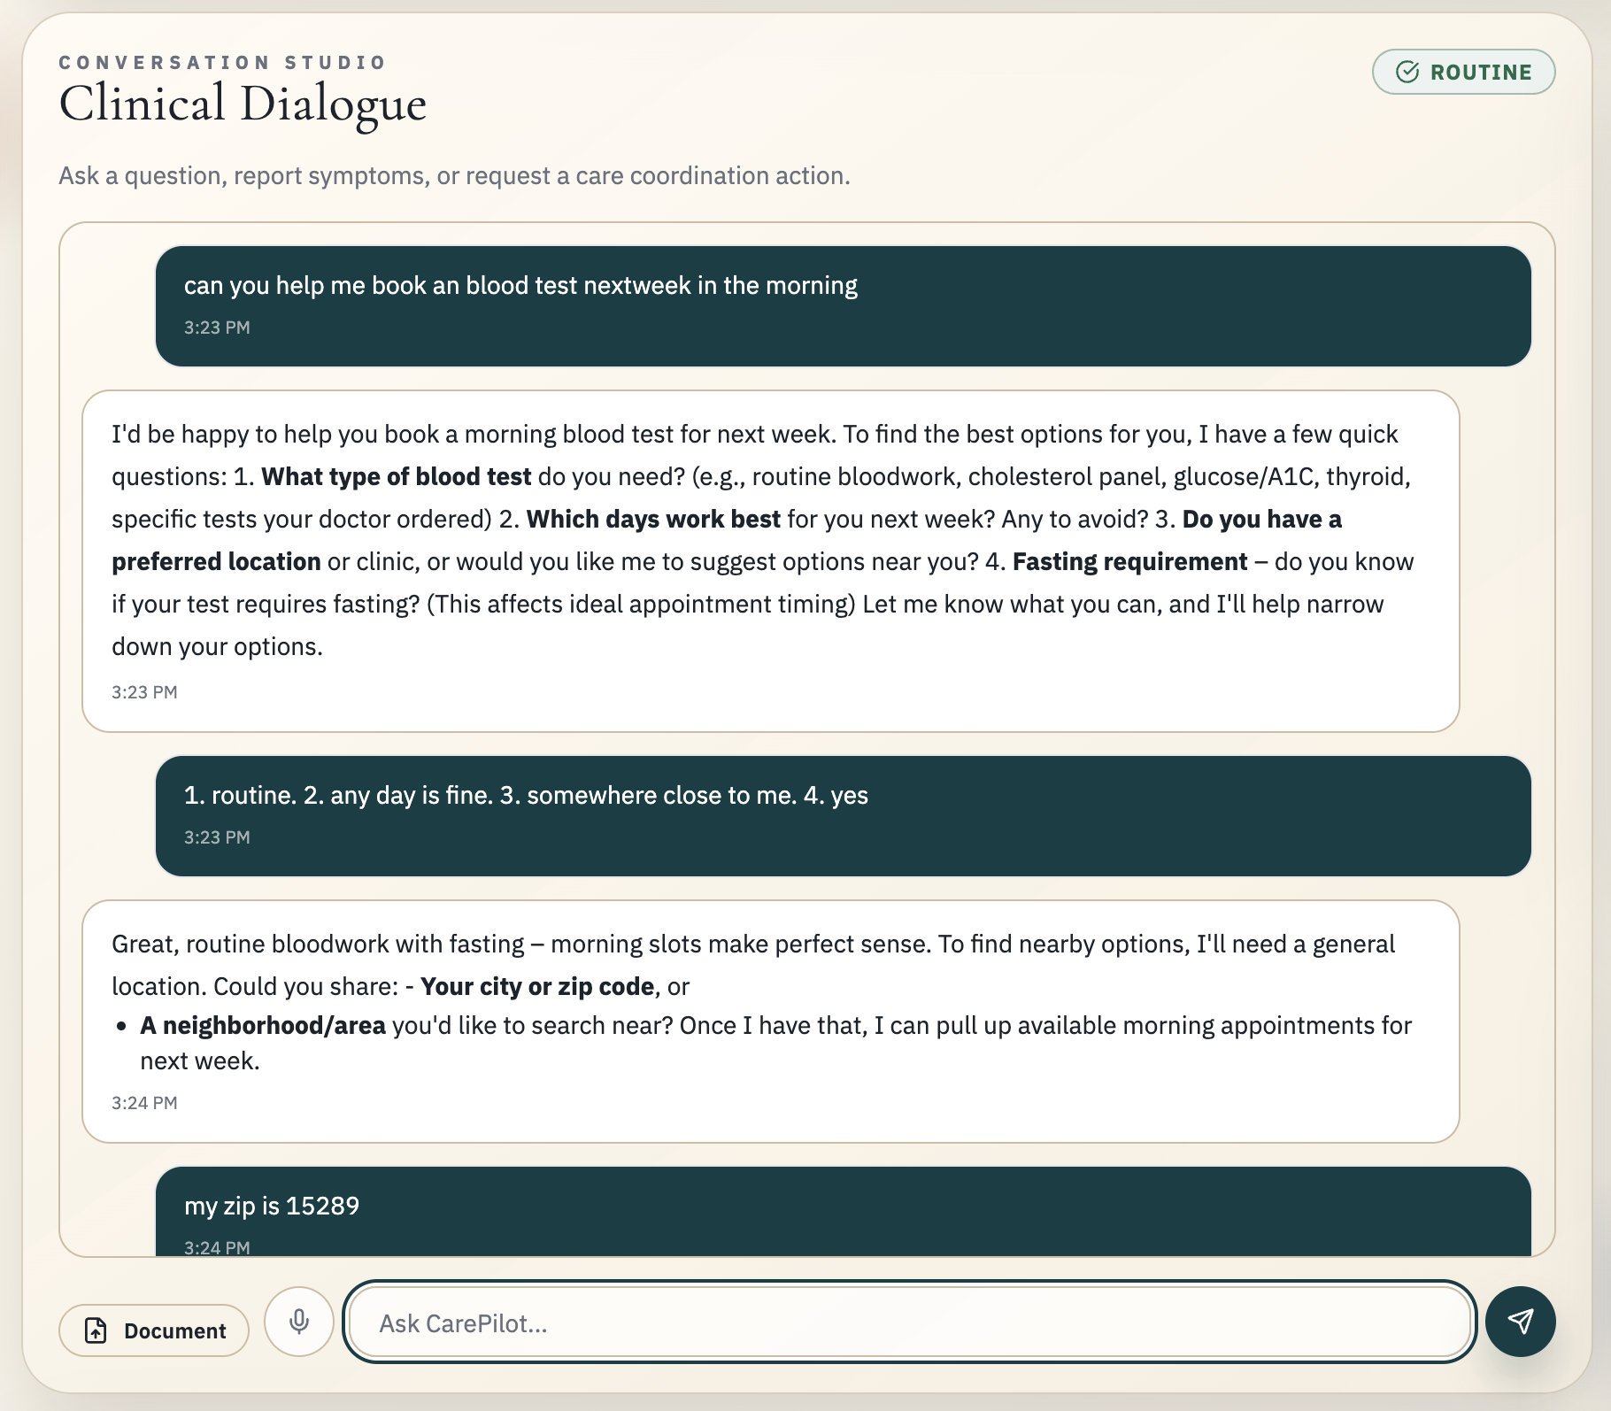
The Solution
Meet CarePilot
Your Personal AI Family Doctor + Medical Secretary
What CarePilot Does
Contextual Health Guidance
Proprietary Clinical Memory
Personalized advice based on your profile
Never repeat your health history
Proactive Health Reminders
Real-World Actions
Timely nudges before issues arise
Book labs, appointments, refills
Connected Health Data
Multimodal Interaction
Apple Health integration
Voice, text, document analysis
Important Disclaimer
CarePilot is designed to support users between doctor visits, not replace licensed clinicians or emergency services. Safety always comes before helpfulness.
24/7
100%
0
Availability
User Control
Data Sharing

Slide 4
CORE FEATURE 1
Intelligent Health Chatbot
Contextual conversations with intelligent triage
Contextual Health Guidance
Intelligent Triage Layer
CarePilot provides educational guidance grounded in your profile data and current symptoms. Every response considers your medical history, medications, and preferences.
Every inbound message is automatically classified to ensure appropriate response:
EMERGENT
"I've had headaches for 3 days."
Emergency redirect only. Immediate safety guidance provided.
"Given your hypertension history, please check your blood pressure today. If headaches persist, consider scheduling a follow-up."
URGENT_24H
Prompt near-term clinical follow-up recommended.
ROUTINE
Standard guidance and optional actions available.
Voice Input Support
Users can talk to CarePilot instead of typing. Voice is transcribed to text, confirmed by the user, and processed through the same safety and triage systems.
Key Benefit
Conversations are grounded in your clinical memory—no need to repeat medications, allergies, or conditions every time you chat.

Slide 5
CORE FEATURE 2
AI Agent for Healthcare Actions
Real-world healthcare admin with user consent
Lab & Clinic Discovery
Medication Refill Workflow
Search and rank nearby labs by distance, availability, and transparent pricing.
Smart run-out predictions using fill date, quantity, and dosage frequency.
1. Quest Diagnostics
2.1 mi • Tue 9:00 AM
CarePilot:
2. Labcorp Midtown
3.0 mi • Tue 10:30 AM
"Based on your last fill, you may have 4 days of Metformin left. About how many pills remain?"
3. City Health Lab
1.8 mi • Wed 8:45 AM
User:
"I have about 5 pills left."
CarePilot:
"I'll request a refill now. Should I proceed?"
Appointment Booking
Consent-First Design
Full lifecycle tracking from planning to completion:
Every action requires explicit user approval. CarePilot prepares actions but never executes without confirmation. Full audit trail maintained.
planned
awaiting_confirmation
executing
succeeded

Slide 6
CORE FEATURE 3
Proactive Care System
Anticipating needs before they become problems
Types of Proactive Outreach
Refill Reminders
"You may run out of Metformin in 5 days. Want me to request a refill?"
Appointment Follow-ups
"You planned to schedule bloodwork 3 days ago. Want help doing it now?"
Health Check-ins
Based on tracked metrics from Apple Health and user-reported symptoms
Trend-based Alerts
"Your activity level dropped this week. Everything okay?"

Slide 7
CORE FEATURE 4
Proprietary Persistent Clinical Memory
Never repeat yourself—CarePilot remembers
Two-Memory Store System
Temporal Memory Lifecycle
CarePilot prevents stale clinical assumptions by classifying memory with time-awareness:
Clinical Store
Structured, safety-critical, PHI-sensitive data
Conditions & diagnoses
LONG_LIVED_FACT
Medications & dosages
Allergies, chronic conditions—permanent unless updated
Allergies & reactions
"Penicillin allergy causes hives"
Lab results & vitals
TIME_BOUND_STATE
Acute symptoms, temporary states—requires reconfirmation
Preference Store
"I am sick" (Day 0 → Day 2 reconfirm → Day 7 auto-resolve)
Conversational patterns and user habits
Communication tone
EVENT & INFERENCE
Reminder preferences
Completed actions and low-trust assumptions with short TTL
Interaction habits
Smart Forgetting
Time-bound states auto-transition to resolved if not reconfirmed. Apple Health trends decay over time to prevent outdated assumptions.

Slide 8
CORE FEATURE 5
Medical Document & Imaging Analysis
Multimodal understanding for better health insights
Supported Document Types
Lab Reports
PDFs and images of blood work, panels, and test results
Example Analysis Output
Imaging Reports
X-rays, MRIs, CT scans, and radiology reports
"Hemoglobin is below reference range"
Direct Image Uploads
"Compared with your prior result, this moved down by 0.8 g/dL"
Photos of documents, test strips, or medical images
"Suggested questions for your doctor: Should I be concerned about this trend?"
Analysis Capabilities
Extract Key Values
Plain Language Summary
Safety First
Identify critical findings and measurements
Translate medical jargon to understandable terms
CarePilot never provides definitive diagnoses from uploaded imaging. For high-risk findings, it recommends urgent professional review.
Flag Abnormal Markers
Follow-up Questions
Highlight out-of-range values and trends
Suggest questions for your clinician

Slide 9
Foundation
Safety & Trust Architecture
Safety runs before helpfulness—always
Emergency Detection
Consent & Action Safety
Every message is scanned for emergency signals. If detected:
Short-Lived Consent Tokens
Immediate emergency guidance provided
Every transactional tool requires fresh consent
1
Policy Hook Blocking
2
Transactional tools blocked for that turn
Missing/expired consent blocks tool execution
No Irreversible Actions
3
Event logged for safety audit
Explicit approval required for all actions
Example: "chest pain + breathing difficulty" → Emergency instructions + no booking/refill

Slide 10
User Experience
End-to-End User Journey
From symptom to action—seamlessly
Example: Fatigue to Lab Booking
1
User Reports Symptom
"I've been feeling unusually tired for the past week."
2
Intelligent Triage
CarePilot classifies as ROUTINE —no emergency signals detected
3
Memory-Grounded Guidance
References user's age, conditions, and suggests CBC + thyroid panel
4
User Approves Action
"Find labs under $100 within 10 miles with morning availability"
5
CarePilot Ranks Options
Returns 3 labs with distance, availability, and pricing
6
Booking Confirmed
User selects option → CarePilot executes booking → Status: succeeded
7
Proactive Follow-up
Reminder scheduled + follow-up nudge to review results

